Slide 1
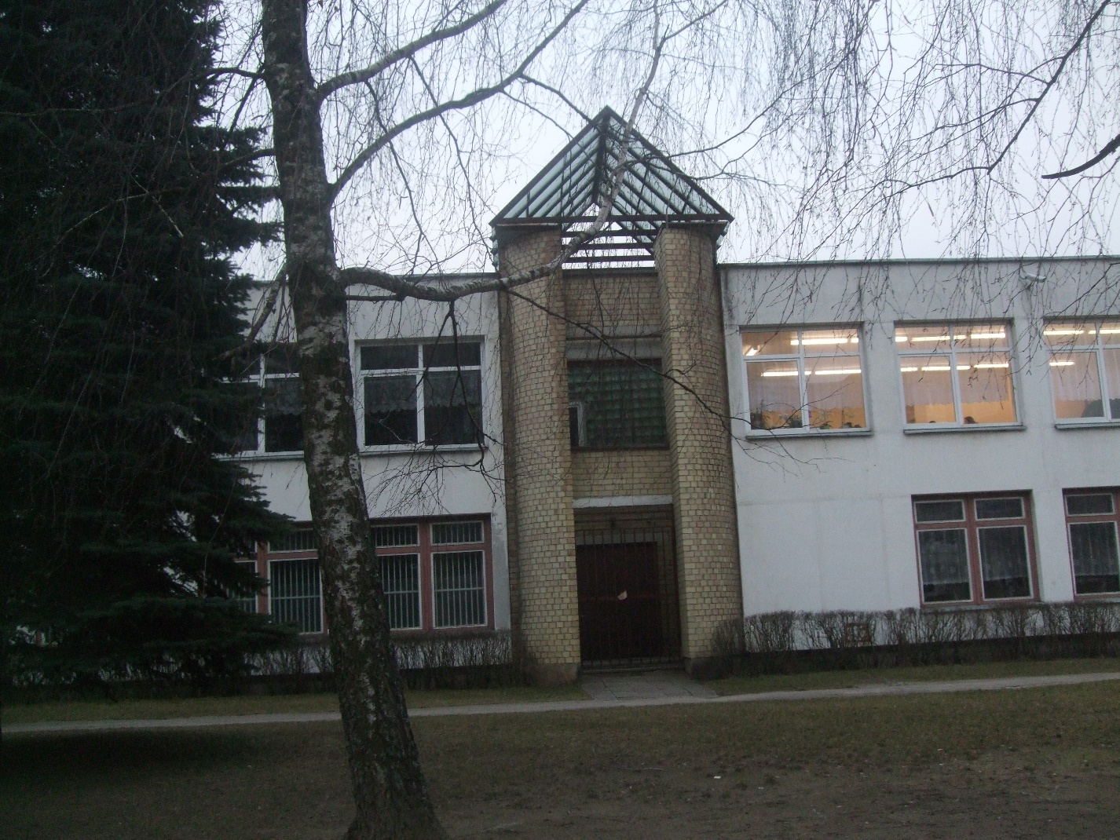
My School

Slide 2
Inside...

Slide 3
My classroom

Slide 4
My teachers and my friends

Slide 5
Library

Slide 6
Gym

Slide 7
Music

Slide 8
Breaks

Slide 10
Celebrations

